Slide 1
New York State Owned Lands Presentation
Prepared for the Town of Tuxedo

Slide 2
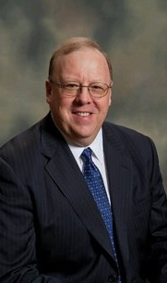
A Proven track record
William "Bill" Beckmann (MAI, CRE, FRICS)
Real estate appraiser at the largest appraisal firm in Rockland County and one of the largest in the Hudson Valley
More than 30 years of appraisal experience along with his unique qualifications
Outstanding reputation as an industry leader throughout the Hudson Valley
Assessor of the Town of Stony Point (Present) and the Village of Spring Valley (Prior)
Appraised all types of property in the Tri state area including NYC and has testified in many cases in NYS Supreme, various Bankruptcy and Federal courts along with NYS Court of Claims
Extensive GIS experience including school redistricting and has developed and audited municipal charges for various Rockland County Municipal Agencies

Slide 3
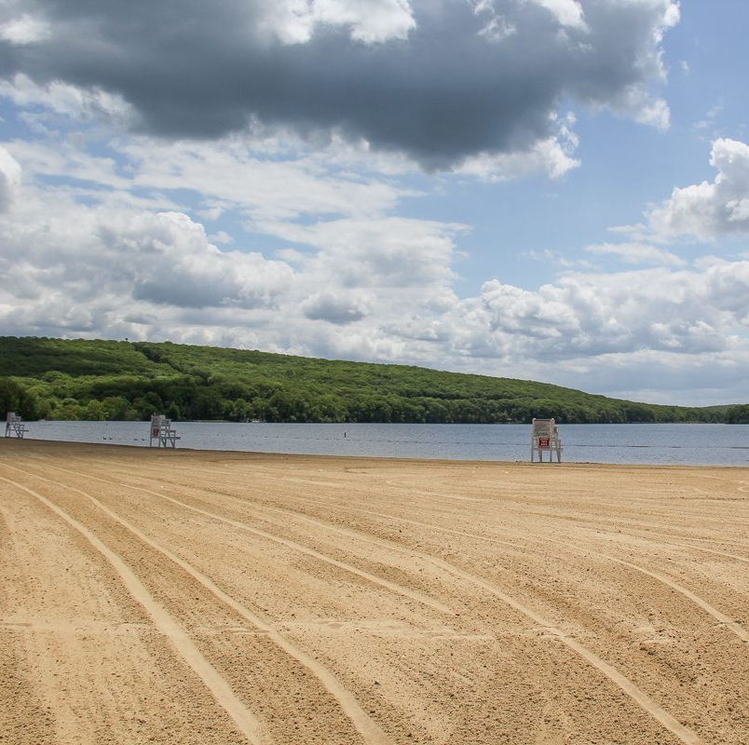
Exhibit stony point
As the Assessor of Stony Point, Mr. Beckmann reassessed the State Owned Lands in Stony Point (2020) with the goal of achieving fair assessments for his 160+ Roll Section 3 Parcels
Mr. Beckmann determined some parcels were overassessed, while others were severely underassessed
Prime examples of underassessed parcels came from the Bear Mountain Park system, Harriman State Park system, and Doodletown area

Slide 4
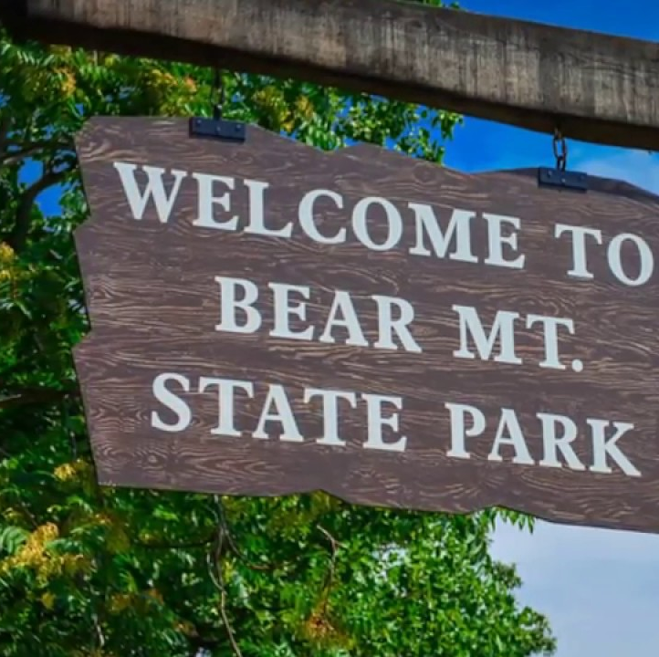
The end result in stony point
Using GIS Systems and Walkthroughs of key parcels, Mr. Beckmann was able to raise Stony Point’s Roll Section Three Assessed Value by 5,021,195 (17% Increase from 2019 Final Roll)
This resulted in an FMV increase of $35,814,514 as well

Slide 5
How we reached the end result
Mr. Beckmann broke up each parcel into subsections with the main ones being:
Primary Acreage
Secondary Acreage
Tertiary Acreage
How Mr. Beckmann categorized each parcel depended on various factors, including a slope analysis
If the parcel was flat, its entire acreage would be considered primary. If a parcel was half on a hill and half flat, half of its acreage would be considered primary and the other half would be considered secondary. Etc.…
Each subsection was then assigned a value depending on various factors and comparable sales we found, with primary acreage receiving the highest value and tertiary receiving the lowest
Mr. Beckmann then multiplied that value by the amount of acres we measured in that subsection and added the various subsections together to reach a new FMV for the parcel (Multiply that new FMV by the equalization rate and you can get your new AV)

Slide 6
Why the end result is important
By taking on this project, Mr. Beckmann was able to raise an additional 5+ million in Assessed Value on Stony Point’s Roll Section 3
By doing so, Mr. Beckmann was able to shift some of the tax burden Stony Point homeowners experience
Based on Stony Point’s tentative roll and the work done with the State Owned Lands project, Mr. Beckmann is projecting the Homestead School Tax rates to decrease in Stony Point (a win for Stony Point residents)

Slide 7
Revaluing state-owned lands in tuxedo
This process is something that we can replicate for the Town of Tuxedo
All parcels would be valued in the same process as we did in Stony Point
Binders would be made including an in-depth analysis of how each parcel was valued as well as comparable sales to back these valuations up
A presentation would then be made to the State on the new values and a settlement would be reached

Slide 8
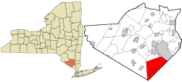
tuxedo parcel 1-1-38.42 example
Current AV: 2,979
Current FMV: 18,400
New AV (2021): 4,582 (54% Increase)
New FMV (2021): 28,318
Please see handout containing information on how we reached this determination. Determination was reached based off similar Stony Point Values.

Slide 9
Questions?

